Slide 1
Parallel & Distributed Computing

Slide 2
Sequential computing (tradition)
A problem is broken into a discrete series of instructions
Instructions are executed sequentially one after another
Executed on a single processor
Only one instruction may execute at any moment in time

Slide 3
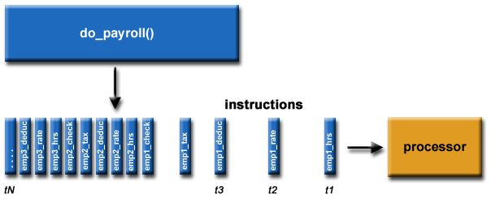
For Example

Slide 4
Why Study Parallelism?
After all, for most of our daily computer uses, sequential processing is plenty fast
It is a fundamental departure from the “normal” computer model, therefore it is inherently cool
The extra power from parallel computers is enabling in science, engineering, business, …
Multicore chips present a new opportunity
Deep intellectual challenges for CS -- models, programming languages, algorithms, HW, …

Slide 5
Parallel Computing
Also called Parallel Processing
A problem is broken into discrete parts that can be solved concurrently
Each part is further broken down to a series of instructions
Instructions from each part execute simultaneously on different processors
An overall control/coordination mechanism is employed

Slide 6
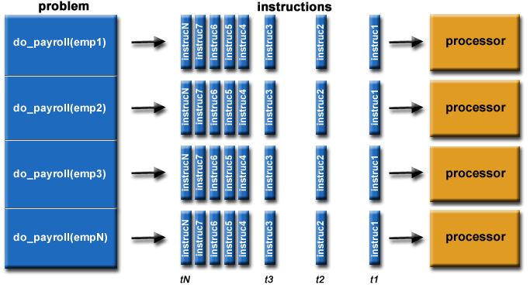
Example

Slide 7
Simple Example
Say we have this equation:
Y = (4 x 5) + (1 x 6) + (5 x 3)
On a single processor, the steps might look like:
Step 1: Y = 20 + (1 x 6) + (5 x 3)
Step 2: Y = 20 + 6 + (5 x 3)
Step 3: Y = 20 + 6 + 15
Step 4: Y = 41
But in a parallel computing scenario, with three processors or computers, the steps look something like:
Step 1: Y = 20 + 6 + 15
Step 2: Y = 41

Slide 8
Why use Parallel Computation?
Increase Computing power (speed, memory)
Cost/Performance
Scalability
Tackle intractable problems

Slide 9
Parallel Computers
Virtually all stand-alone computers today are parallel from a hardware perspective:
Multiple functional units (L1 cache, L2 cache, branch, prefetch, decode, floating-point, graphics processing (GPU), integer, etc.)
Multiple execution units/cores
Multiple hardware threads
Networks connect multiple stand-alone computers (nodes) to make larger parallel computer clusters.

Slide 10


What problems need Parallel Computing?

Slide 11


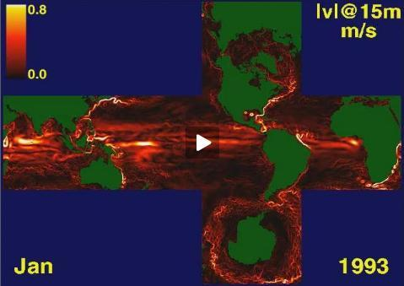
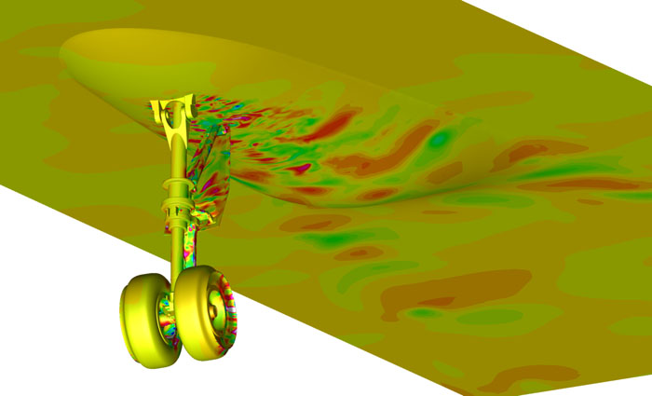
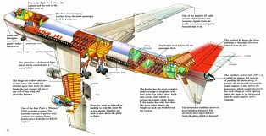
Parallel Computing in the Real-world
Engineering
Science
Business
Game
Cloud-computing

Slide 12
Everyday Parallelism
Juggling -- event-based computation
House construction -- parallel tasks, wiring and plumbing performed at once
Assembly line manufacture -- pipelining, many instances in process at once
Call center -- independent tasks executed simultaneously

Slide 13
Classifying Parallel Computers
There are a number of different ways to classify parallel computers. Examples are available in the references.
One of the more widely used classifications, in use since 1966, is called Flynn's Taxonomy.

Slide 14
Flynn’s Taxonomy Classification Scheme for Parallel Computers
Data Stream
Single
Multiple
Single
SISD
SIMD
Instruction Stream
Multiple
MISD
MIMD

Slide 15
Types of Parallel Categories (2)
Single instruction, Single Data (SISD) stream
Single processor executes a single instruction stream to operate on data stored in a single memory
Uniprocessors fall into this category
Single instruction, multiple data (SIMD) stream
A single machine instruction controls the simultaneous execution of a number of processing elements on a lockstep basis
Vector and array processors fall into this category
Notes:
A taxonomy first introduced by Flynn [FLYN72] is still the most common way of categorizing systems with parallel processing capability. Flynn proposed the following categories of computer systems:
Single instruction, single data (SISD) stream: A single processor executes a single instruction stream to operate on data stored in a single memory. Uniprocessors fall into this category.
Single instruction, multiple data (SIMD) stream: A single machine instruction controls the simultaneous execution of a number of processing elements on a lockstep basis. Each processing element has an associated data memory, so that instructions are executed on different sets of data by different processors. Vector and array processors fall into this category, and are discussed in Section 18.7.
Multiple instruction, single data (MISD) stream: A sequence of data is transmitted to a set of processors, each of which executes a different instruction sequence. This structure is not commercially implemented.
Multiple instruction, multiple data (MIMD) stream: A set of processors simultaneously execute different instruction sequences on different data sets. SMPs, clusters, and NUMA systems fit into this category.

Slide 16
Types of Parallel Categories (3)
Multiple instruction, single data (MISD) stream
A sequence of data is transmitted to a set of processors, each of which executes a different instruction sequence
Systolic arrays: think data pump or pumping-heart model (not many built)
Multiple instruction, multiple data (MIMD) stream
A set of processors simultaneously execute different instruction sequences on different data sets
SMPs, clusters and NUMA systems fit this category
Multiprocessors and multi-computers
Notes:
A taxonomy first introduced by Flynn [FLYN72] is still the most common way of categorizing systems with parallel processing capability. Flynn proposed the following categories of computer systems:
Single instruction, single data (SISD) stream: A single processor executes a single instruction stream to operate on data stored in a single memory. Uniprocessors fall into this category.
Single instruction, multiple data (SIMD) stream: A single machine instruction controls the simultaneous execution of a number of processing elements on a lockstep basis. Each processing element has an associated data memory, so that instructions are executed on different sets of data by different processors. Vector and array processors fall into this category, and are discussed in Section 18.7.
Multiple instruction, single data (MISD) stream: A sequence of data is transmitted to a set of processors, each of which executes a different instruction sequence. This structure is not commercially implemented.
Multiple instruction, multiple data (MIMD) stream: A set of processors simultaneously execute different instruction sequences on different data sets. SMPs, clusters, and NUMA systems fit into this category.

Slide 17
A Taxonomy of Parallel Processor Architectures
Notes:
With the MIMD organization, the processors are general purpose; each is able to process all of the instructions necessary to perform the appropriate data transformation. MIMDs can be further subdivided by the means in which the processors communicate (Figure 20.1). If the processors share a common memory, then each processor accesses programs and data stored in the shared memory, and processors communicate with each other via that memory. The most common form of such system is known as a symmetric multiprocessor (SMP), which we examine in Section 20.2. In an SMP, multiple processors share a single memory or pool of memory by means of a shared bus or other interconnection mechanism; a distinguishing feature is that the memory access time to any region of memory is approximately the same for each processor. A more recent development is the non-uniform memory access (NUMA) organization, which is described in Section 20.6. As the name suggests, the memory access time to different regions of memory may differ for a NUMA processor.
A collection of independent uniprocessors or SMPs may be interconnected to form a cluster. Communication among the computers is either via fixed paths or via some network facility.

Slide 18
Alternative Computer Organizations
Notes:
Figure 20.2 illustrates the general organization of the taxonomy of Figure 20.1. Figure 20.2a shows the structure of an SISD. There is some sort of control unit (CU) that provides an instruction stream (IS) to a processing unit (PU). The processing unit operates on a single data stream (DS) from a memory unit (MU). With an
SIMD, there is still a single control unit, now feeding a single instruction stream to multiple PUs. Each PU may have its own dedicated memory (illustrated in Figure 20.2b), or there may be a shared memory. Finally, with the MIMD, there are multiple control units, each feeding a separate instruction stream to its own PU. The MIMD may be a shared-memory multiprocessor (Figure 20.2c) or a distributed- memory multicomputer (Figure 20.2d).
The design issues relating to SMPs, clusters, and NUMAs are complex, involving issues relating to physical organization, interconnection structures, inter-processor communication, operating system design, and application software techniques. Our concern here is primarily with organization, although we touch briefly on operating system design issues.

Slide 19
What is Distributed Computing
Activities performed on a distributed system
A distributed system is one in which components located at networked computers communicate and coordinate their actions only by passing messages.

Slide 20
Characteristics of distributed systems:
Concurrency of components
Lack of a global ‘clock’
Independent failures of components

Slide 21
2. Examples of Distributed Systems
Local Area Network and Intranet
Database Management System
Automatic Teller Machine Network
Internet/World-Wide Web
Mobile and Ubiquitous Computing
Notes:
We now review several systems that most of you have come across already (possibly without being aware that they are distributed).
This review will provide you with a better understanding of the issues that are to be tackled during distributed systems construction.

Slide 22
2.1 Local Area Network
Notes:
A local area network consists of a number of different computers. Workstations and Personal computers provide the front-end for network users. Different servers provide shared services.
One or several network file servers provide data storage services. Any workstation and PC may henceforth store files on disks maintained by these file servers.
A local name server maps machine names to IP addresses, user names to user ids and group names to group ids. Any machine can request a service to resolve a certain name.
One or several print servers control the access to shared printers.Workstations and PCs have the server printing jobs for them.
Another component provides a gateway to the wide area network.
As a user you need not be aware which machine provides which service.
Name servers provide the information regarding machine (by IP address), user names (by user ids), and group name (by group ids).
Local area networks can be connected together to form Intranets.

Slide 23
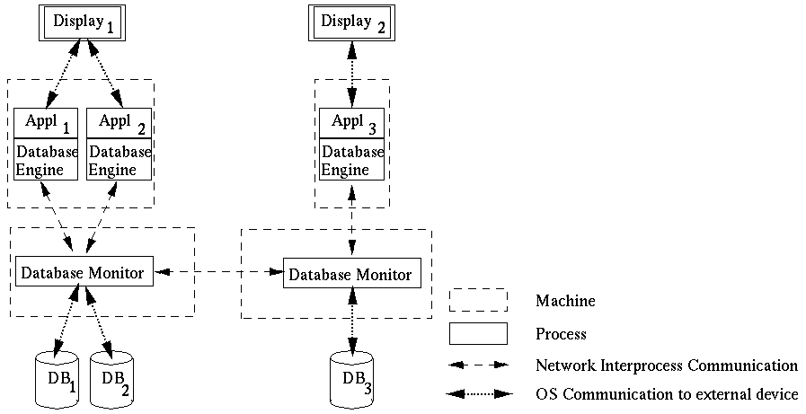
2.2 Database Management System
Notes:
Different client applications want to access and update shared data in a database.
Client applications might be banking systems, real-estate agencies, airline-ticket reservation systems accessing data like balances of bank accounts, details of property that are for sale or to let, or airfares and aircraft reservation data.
The database is physically distributed over several processors to take advantage of local data accesses for increased performance of client applications.
Data may be replicated to reduce the impact of failures of a processor and/or the network.
Each processor runs a database monitor that implements the mapping between the database seen by clients and the physical database stored on the different processors.
Database monitors have to cooperate with each other to implement client accesses to remote data, updates of replicated data and concurrency control.
The physical distribution of data is therefore transparent to clients.

Slide 24
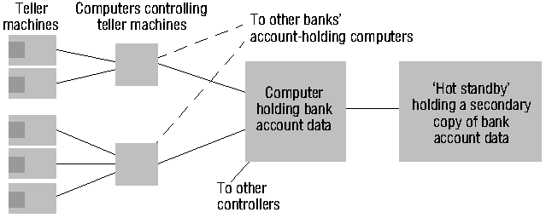
2.3 Automatic Teller Machine Network
Notes:
An automatic teller machine network enables bank customers to withdraw cash from their bank account.
Banks and building societies maintain large networks of teller machines.
Customer have high security, privacy and reliability requirements.
Customers may want to withdraw cash from their account through a ´foreign´ teller machine.
A front-end computer controls one or several tellers. It
transfers withdrawal requests to the computer of the account holder´s bank,
awaits the bank granting the request, and
therefore has to be interoperable with heterogeneous computer systems (Hang Seng Bank may have different account management systems than HongKong Bank and Bank of China).
Each bank has fault-tolerant systems to quickly recover from failures of their account holding computers. An example is the ´Hot standby´ computer which maintains a copy of the account database and can replace the main computer within seconds.

Slide 25
2.4 Internet
intranet
%
ISP
%
%
%
backbone
satellite link
desktop computer:
server:
network link:
Notes:
Internet is the largest distributed system in the world.

Slide 26
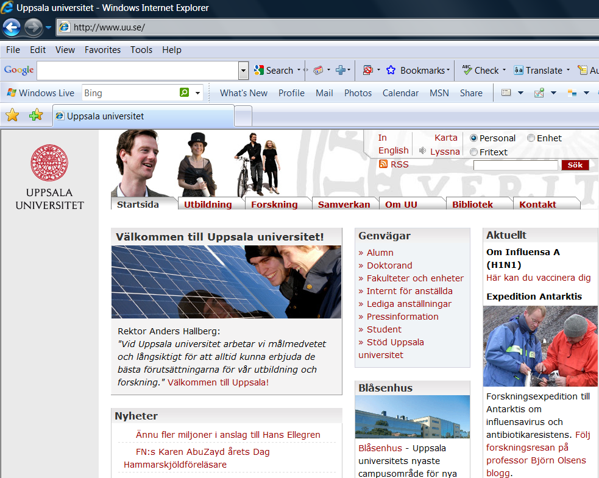
2.4.1 World-Wide-Web
Notes:
World Wide Web is the largest software application running on Internet. It becomes the most popular distributed software application ever created.

Slide 27
2.4.2 Web Servers and Web Browsers
http://www.google.comlsearch?q=lyu
www.google.com
Web servers
Browsers
www.uu.se
Internet
http://www.uu.se/
www.w3c.org
File system of
http://www.w3c.org/Protocols/Activity.html
www.w3c.org
Protocols
Activity.html
Notes:
A Web browser is a user interface to the world´s biggest distributed system, the Internet.
A Web page includes links to other Web pages. These links are specified as URLs.
An URL is the name of a protocol (ftp, http, etc.), the name of a site (gateway1.cse.cuhk.edu.hk) and the name of a file.
To follow a link to a remote Web page, your Web browser
talks to the local name server to resolve the symbolic site name into an IP address (137.189.89.153).
talks to the http daemon running on that web site and requests the delivery of the Web page addressed by the URL.
To obtain a file from a remote ftp site, your Web browser
resolves the site name with the local name server
talks to the ftp daemon running on that site and performs an anonymous login.
switches the daemon into an appropriate transfer mode and
obtains the file addressed by the file addressed in the URL.
To send an e-mail, your Web browser
opens a new dialog window where you can enter the addressee(s) and the e-mail text
talks to the local sendmail daemon to have it delivering the e-mail to the sendmail daemons on the sites of your addressees.

Slide 28
2.5 Mobile and Ubiquitous Computing
Internet
Host intranet
GSM/GPRS
Home intranet
Wireless LAN
gateway
Mobile
phone
Printer
Laptop
Camera
Host site
Notes:
Mobile and ubiquitous computer extend the access of Internet and distributed system architecture from wire-line connections to wireless connections.

Slide 29
Parallel vs Distributed Computing
Comparisons are often matters of degree
Characteristic | Parallel | Distributed
Overall Goal | Speed | Convenience
Interactions | Frequent | Infrequent
Granularity | Fine | Coarse
Reliable | Assumed | Not Assumed

Slide 30
Comparison (1)
Parallel Computing
Distributed Computing
Many operations are performed simultaneously
Single computer is required
Multiple processors perform multiple operations
System components are located at different locations
Uses multiple computers
Multiple computers perform multiple operations

Slide 31
Comparison (2)
Parallel Computing
Distributed Computing
It may have shared or distributed memory
Processors communicate with each other through bus
Improves the system performance
It may have shared or distributed memory
Computer communicate with each other through message passing.
Improves system scalability, fault tolerance and resource sharing capabilities

Slide 32
